Slide 1
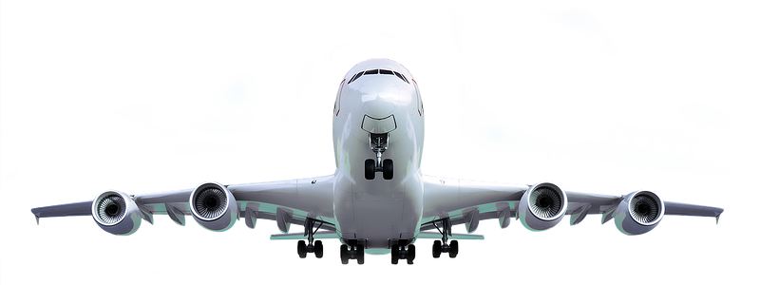

AEROSPACE
ENGINEERING

Slide 2



AEROSPACE
Where It's Used: Aerospace engineering ranges from commercial airplanes to satellites and rockets.
Key Skills:
Aerospace engineers use many skills including aerodynamics, materials science, and propulsion systems
What It Is:
Aerospace engineering focuses on the design, development, and testing of aircraft and spacecraft.

Slide 3
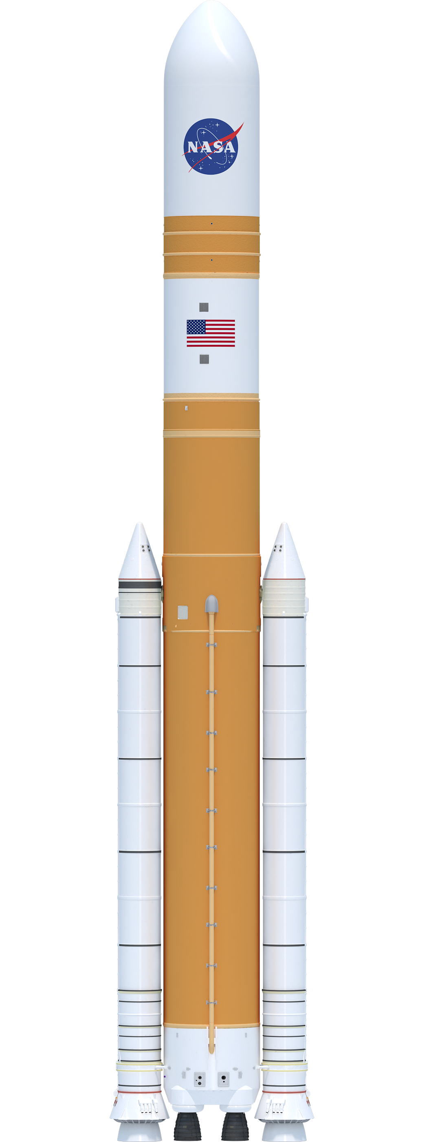
AEROSPACE
What It Is:
Aerospace engineering focuses on the design, development, and testing of aircraft and spacecraft.
Key Skills:
Aerospace engineers use many skills including aerodynamics, materials science, and propulsion systems
Where It's Used: Aerospace engineering ranges from commercial airplanes to satellites and rockets.

Slide 4
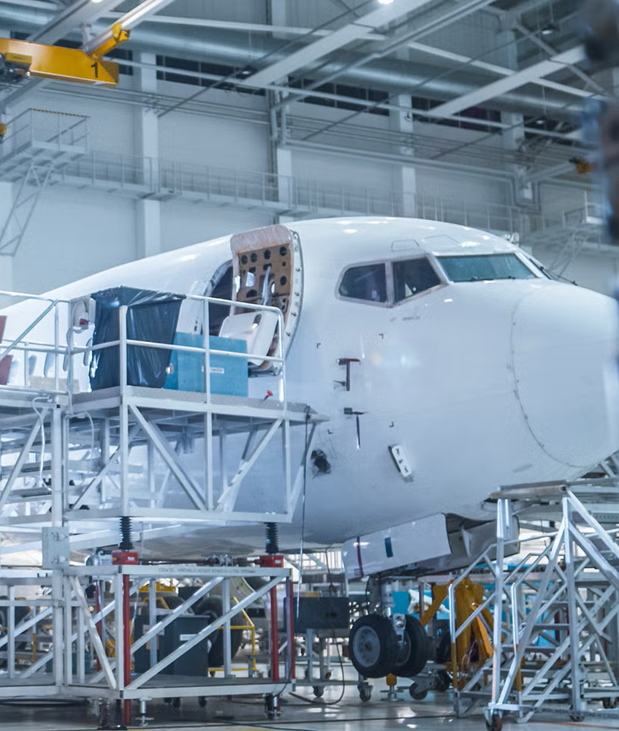
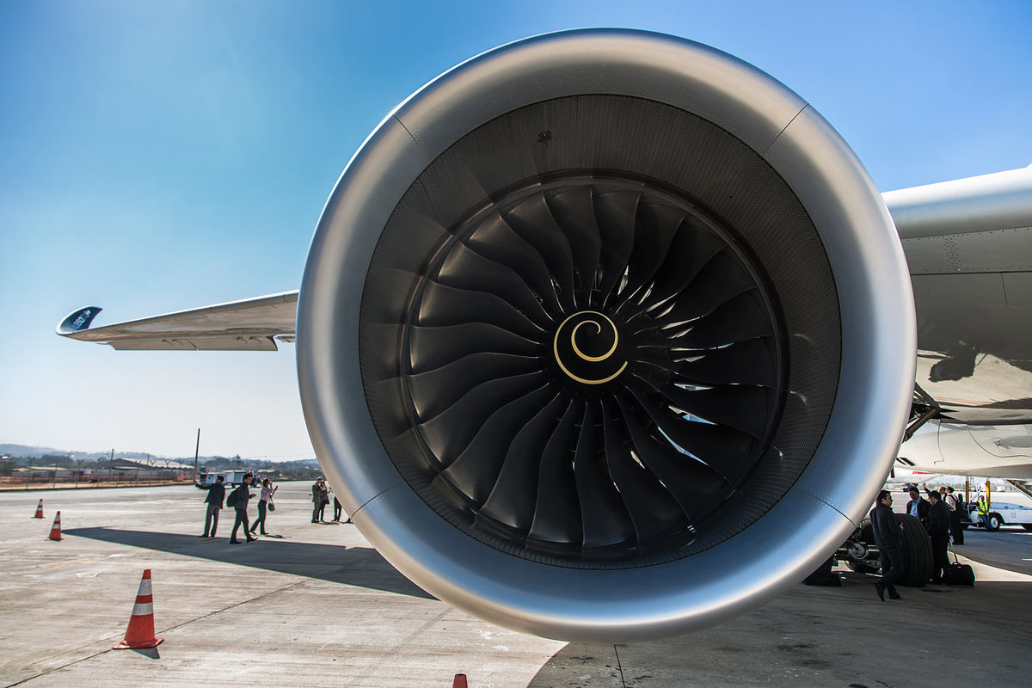
What Do Aerospace
Engineers Do?
Aerospace Engineers:
Aerospace Engineers design and develop aircraft and spacecraft.
This includes commercial airplanes, military jets, satellites, and rockets.
They ensure these vehicles are safe, efficient, and capable of performing their missions.
Aerospace
Engineering Fields
Propulsion Engineers:
Design the engines that provide rockets, missiles, satellites and other spacecraft with the means to move in the air or in space

Slide 5
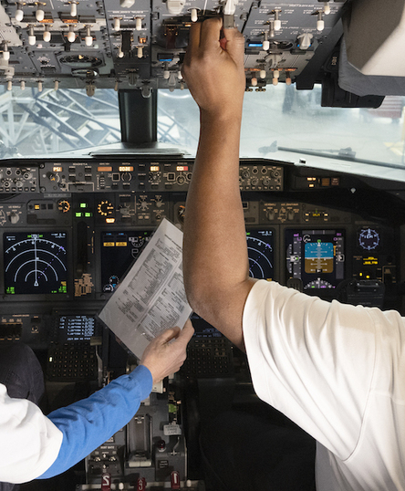
What Do Aerospace
Engineers Do?
Aerospace Engineers:
Aerospace Engineers design and develop aircraft and spacecraft.
This includes commercial airplanes, military jets, satellites, and rockets.
They ensure these vehicles are safe, efficient, and capable of performing their missions.
Aerospace
Engineering Fields
Propulsion Engineers:
Design the engines that provide rockets, missiles, satellites and other spacecraft with the means to move in the air or in space

Slide 6
What Do Aerospace
Engineers Do?
Aerospace Engineers:
Aerospace Engineers design and develop aircraft and spacecraft.
This includes commercial airplanes, military jets, satellites, and rockets.
They ensure these vehicles are safe, efficient, and capable of performing their missions.
Aerospace
Engineering Fields
Avionics Engineers:
Design and maintain the electronic systems in aircraft and spacecraft, such as navigation, communication, and control systems.

Slide 7
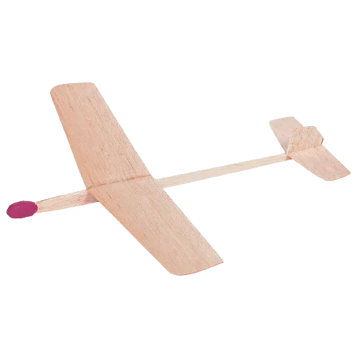
Balsa Wood Glider
Project
Your goal is to design and construct a glider out of balsa wood.
The challenge is to design the furthest flying plane.
You will have to consider many factors such as: lift, weight, design, etc
Materials:
2 sheets of balsa wood
Wood glue
X-Acto knife
Clay (for balancing)

Slide 8
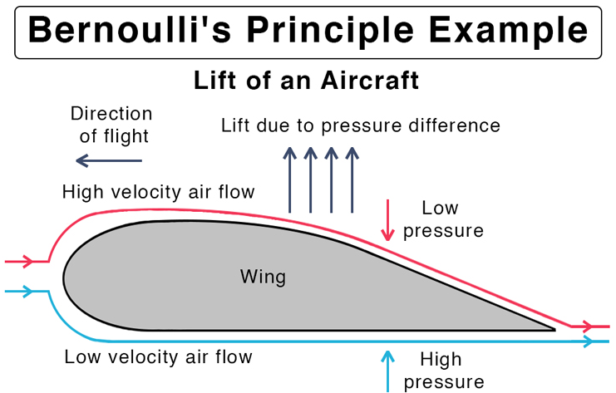
Key Lesson:
Lift
An easy way to make your plane fly farther is to shape the wings in a specific (airfoil) way, but do you know why?
Bernoulli’s Principle:
Air pressure difference: When air moves faster, the pressure is lower. When it moves slower, the pressure is higher.
Wings and air: The shape of a wing (which is called an airfoil) makes air move faster over the top and slower under the bottom.
Lift: The lower pressure on top and higher pressure underneath creates a force that pushes the wing up – this is called lift.

Slide 9
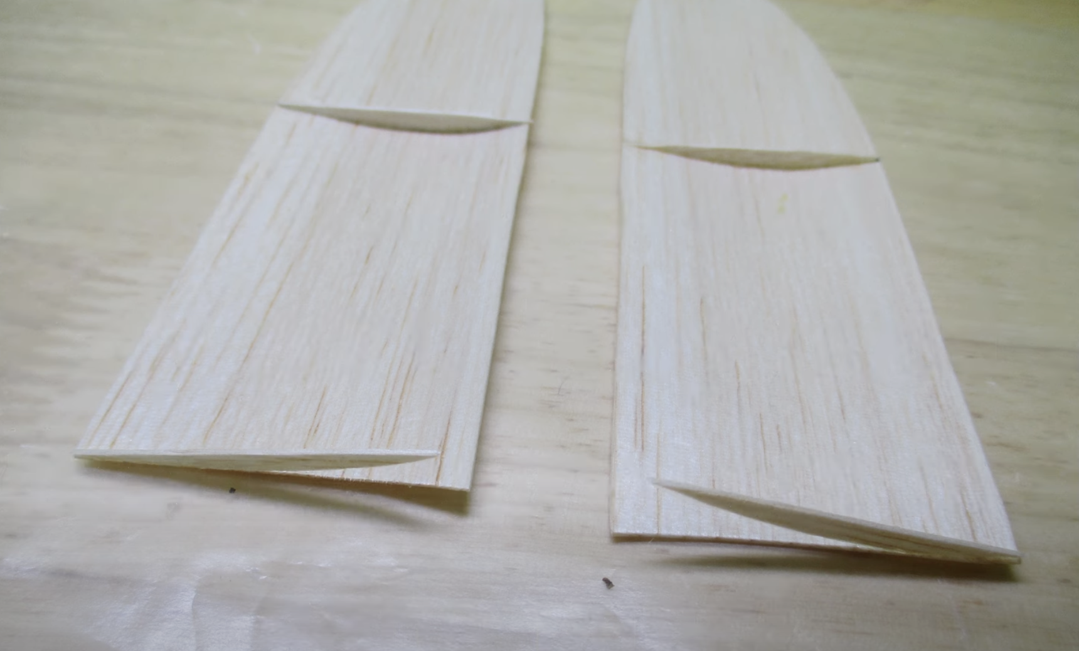
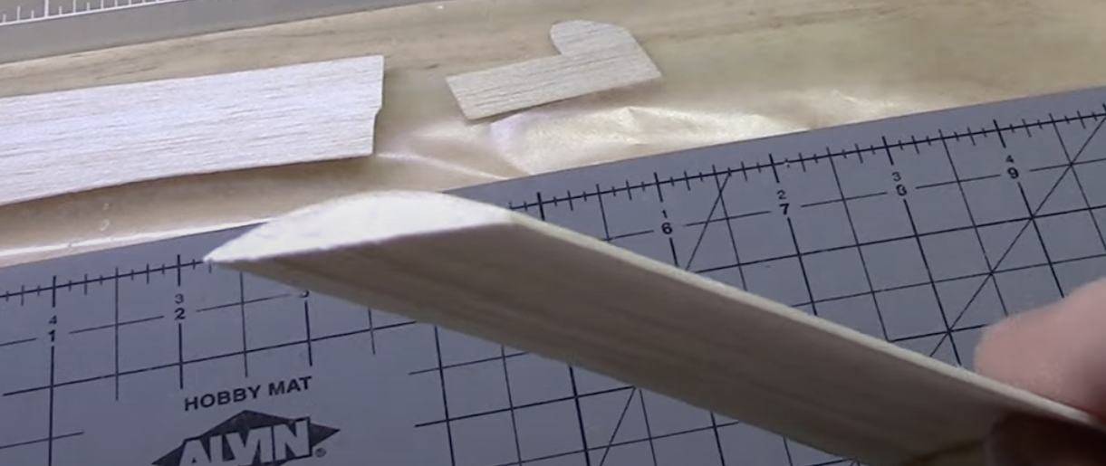
Key Lesson:
Airfoil
Key Lesson:
Lift
The best way to shape your wing is using cutouts called “ribs”
Cutout small pieces of wood that resemble an airfoil
Glue them to the bottom of your wing and apply pressure to make the wing follow the curve
An easy way to make your plane fly farther is to shape the wings in a specific (airfoil) way, but do you know why?
Bernoulli’s Principle:
Air pressure difference: When air moves faster, the pressure is lower. When it moves slower, the pressure is higher.
Wings and air: The shape of a wing (airfoil) makes air move faster over the top and slower under the bottom.
Lift: The lower pressure on top and higher pressure underneath creates a force that pushes the wing up – this is called lift.

Slide 10
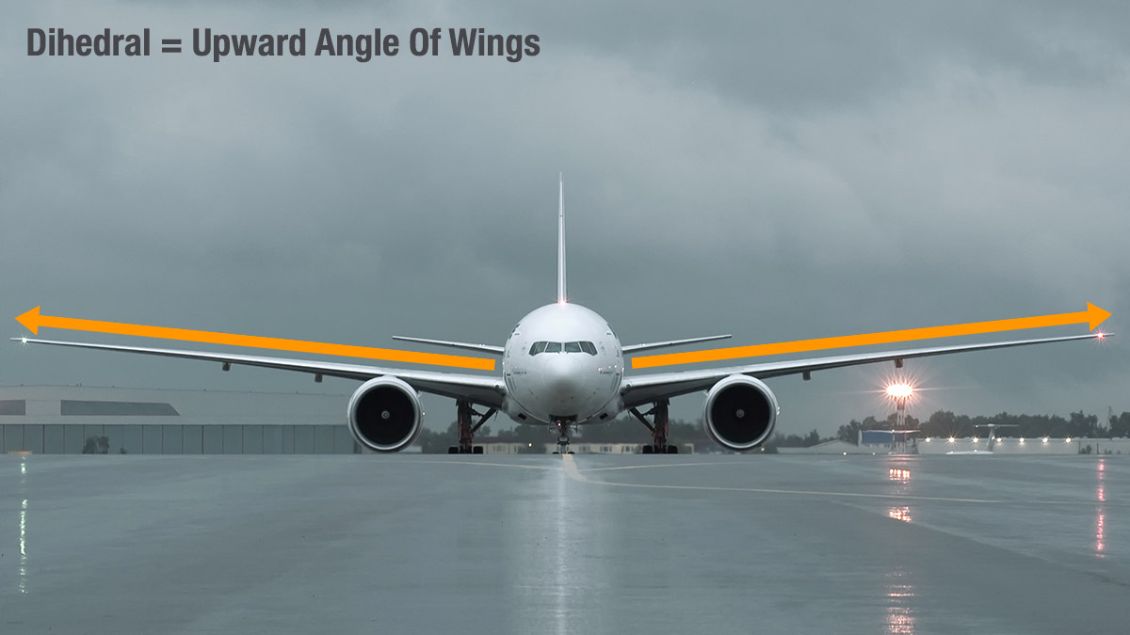
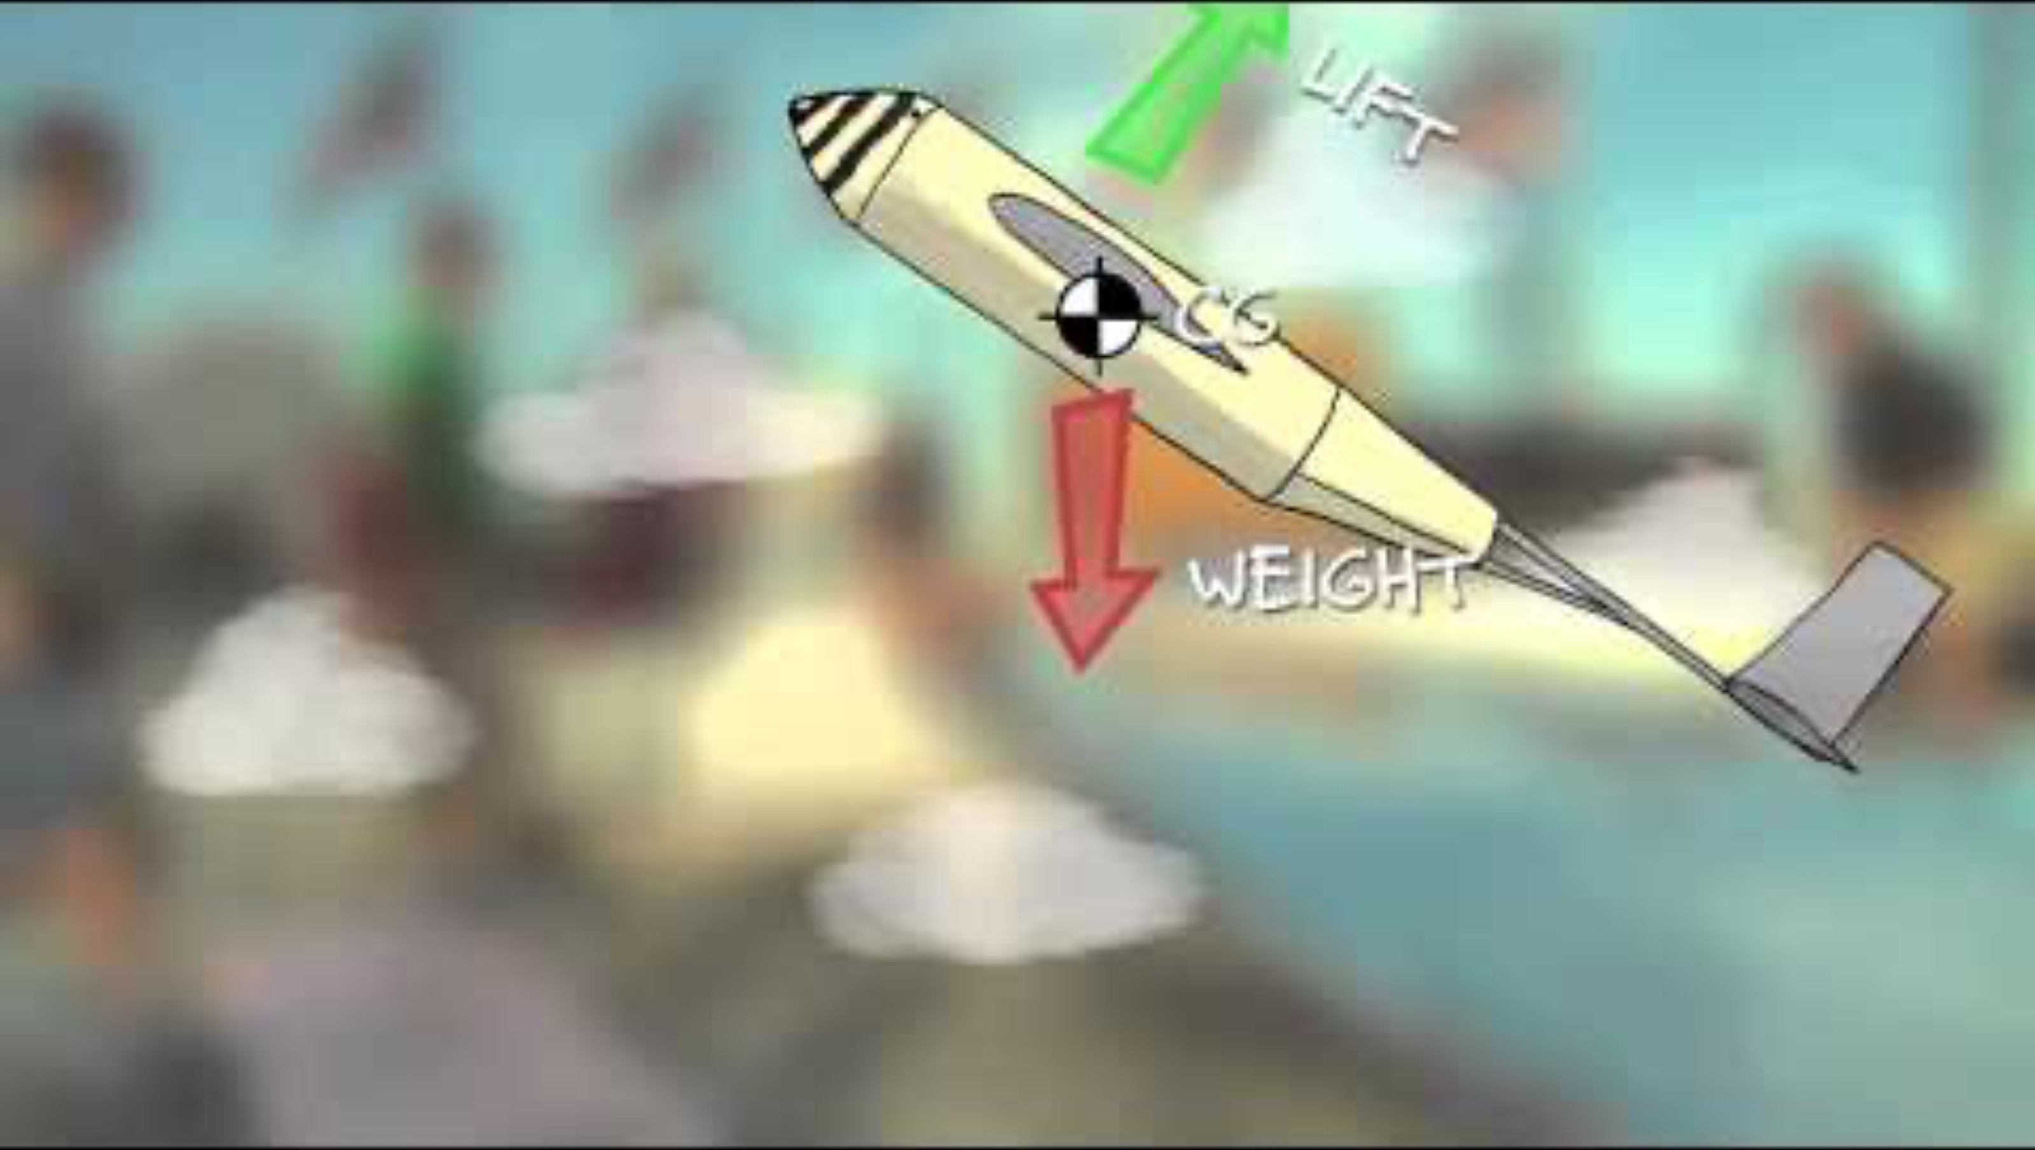
Key Lesson:
Stability
If you want your plane to fly far it has to be stable in the air!
There are two main ways to make your glider stable
Dihedral:
Dihedral is the upward angle of a plane’s wings
Dihedral wings increase the planes stability during flight but you have to find the right angle
Center of Gravity (CG):
You can change the CG by adding small weights (clay)
Move CG Forward: add clay to the front
Move CG Backward: add clay to the back

